Slide 1
Teaching Biostatistical Literacy: A Flipped-Classroom Approach
Joint Statistical Meetings, Chicago
August 1, 2016
Ann M. Brearley
Biostatistical Design and Analysis Center,
Clinical and Translational Sciences Institute,
University of Minnesota
brea0022@umn.edu

Slide 2
Outline
Our literacy course
Background, audience, goal, topics
Our teaching approach
Inverted or ‘flipped’ classroom
Challenges and rewards of the flipped-classroom approach
Notes:
Only brief summary of course content – focus here is on teaching methods

Slide 3
Gap in Introductory Biostatistics Education
Standard approach
Focus on data analysis
Does not meet needs of many students
Clinicians, public health professionals vs. researchers, data analysts
A different approach is needed for these students
Focus on literacy

Slide 4
Literacy Course Student Audience
MPH, MS, MHA, MHI programs
Public Health Practice (9) – mostly DVM, MD, PharmD
Environmental Health (6) – RNs, MDs, people from industry
Maternal and Child Health (4) – mostly MDs
Health Informatics (4)
Community Health Promotion (3) – one journalist
Public Health Administration and Policy (3) – one JD/MPH
Nutrition (2)
Health-care administration (1)
Clinical Research (1)
Kinesiology (1)
Core Concepts (9)
Dentistry residency (16)
Pharmacy residency (5)
PhD or DNP Nursing (3)
PhD Computational Biology (1)
Non-degree (9) – MD, RN, dental hygiene
Notes:
Student backgrounds are from PubH 6414 Online, Fall 2012.
Medical and public health professionals. Wide range of backgrounds and interests.

Slide 5
Literacy Course Primary Course Goal
PubH 6414 Biostatistical Literacy has the primary goal of developing student ability to read and interpret statistical results in the primary literature of their specific scientific field of interest.
This course will involve minimal calculation and offer no formal training in any statistical programming software.
The focus will be when to use a given method and how to interpret the results, not the actual computation or computer programming to obtain results from raw data.
Notes:
Wording is taken from the course syllabus.
NO SOFTWARE. NO DATA ANALYSIS.
This course complements our other main introductory statistics course sequence, PubH 6450-6451, in which students learn to do statistical analyses in R or SAS.

Slide 6
Literacy Course Course Topics by Unit (Week)
Introduction, study designs, sampling methods
Survival data, Kaplan-Meier curves
Sampling distributions, confidence interval for a proportion
Summarizing continuous variables (tables, plots)
Confidence interval for a mean
Hypothesis testing
Challenges (multiple testing, normality, outliers)
Statistical tests I: comparing proportions, risks, odds
Statistical tests II: comparing survival curves, means, paired means
Communicating risk, sensitivity, specificity, PPV
Correlation, simple linear regression
Multiple linear regression
Logistic and proportional hazards regression
ANOVA
Island Project Presentations
Notes:
What we teach: Content: standalone ONE-semester course.
Traditional introductory topics (e.g. hypothesis testing, SLR) PLUS more advanced topics (e.g. logistic regression, survival analysis)

Slide 7
Literacy Course Teaching Approach
Inverted (flipped) classroom
Focus is on learning by doing
Steps (same every week):
Pre-week: preparation and readiness quiz
Class time: learning activities and discussion
Lab time: Island project
End-of-week: review and final quiz
Notes:
How we teach it: Structure / Methods
Co-taught by the OL and IP instructors
Flipped classroom and active learning are essentially the same thing (flipped means put the passive part outside of class and the active part inside of class)

Slide 8
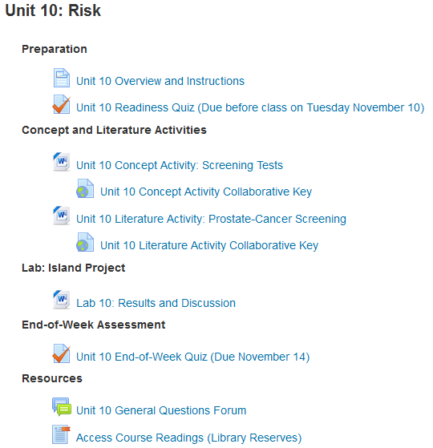
Example Unit Outline
Learning objectives, readings
and recorded lectures
Notes:
Example unit outline (from Moodle, Fall 2015 in-person section)

Slide 9
Literacy Course Learning Objectives: Example
Unit 12: Multiple Linear Regression (MLR)
Be able to describe when multiple linear regression can be used, and what it is used for.
Be able to write down the equation for a multiple linear regression model (including interaction terms) and describe what each parameter means.
Know what kind of a plot is used to assess how well a multiple linear regression model fits the data, and be able to interpret both the plot and the model R² value.
Be able to interpret the fitted model regression coefficients, and make a conclusion from their confidence intervals and p-values.
Be able to explain what ‘variable selection’ is, how to recognize it in an article, and why it is a potential issue.
Be able to recognize or give examples of study designs which result in correlated data and cannot be analyzed using MLR.
Notes:
Course development starts with developing overall course goals and then weekly learning objectives.
Learning objectives are KEY! Focus on what students should be able to DO at the end of the unit.
Instructors use the learning objectives as they teach to:
Write/revise the lectures
Design/revise the learning activities
Write/revise the assessments
Students are encouraged to use the learning objectives to guide their learning.

Slide 10

Literacy Course Pre-week Preparation
Review the learning objectives
Listen to a few short recorded audio lectures (or read the scripts)
Read several selections from the textbook
Harvey Motulsky, Intuitive Biostatistics: A Nonmathematical Guide to Statistical Thinking, 3rd Ed. (Oxford, 2014)
Notes:
Students typically do the preparation on the weekend before, or on Monday if the class is on Tuesday/Thursday.

Slide 11
Literacy Course Pre-Week Assessment: Readiness Quiz
Formative assessment
Tests a basic level of understanding (e.g. terminology), so students are prepared for the in-class learning activities
About 20 multiple-choice questions, takes ~20 min.
Administered online
Can take it twice, best score counts
Encouraged to take it with a study partner or group
Weekly, so low stakes
Example question:
True/False: If the hazard ratio for death is less than 1.0, it means that the group of interest has a lower hazard of death, or longer survival, compared to the reference group.
Notes:
The quiz itself is a learning activity.

Slide 12
Literacy Course In-Class Learning Activities
Tuesdays: Concept Activity
Focus is on understanding a key concept for the unit, e.g. what is a sampling distribution
Some of these involve using software applets such as StatKey
Thursdays: Literature Activity
Focus is on reading and understanding an article from the medical or public health literature
Notes:
Each activity takes one class period, or about 1.25 hours.
Students work in table groups or pairs
Active classroom is ideal, but any classroom with movable tables and chairs works
Instructor(s) and classroom TA circulate to answer questions, listen for confusion, ask questions
Two instructors/CTAs are sufficient for a class of about 50 students

Slide 13
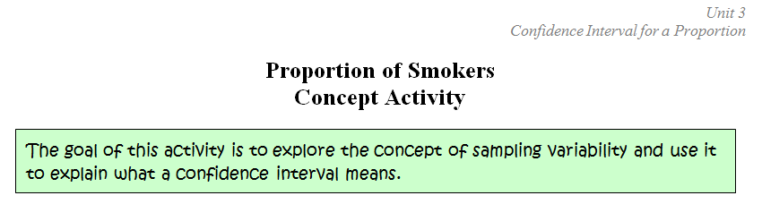
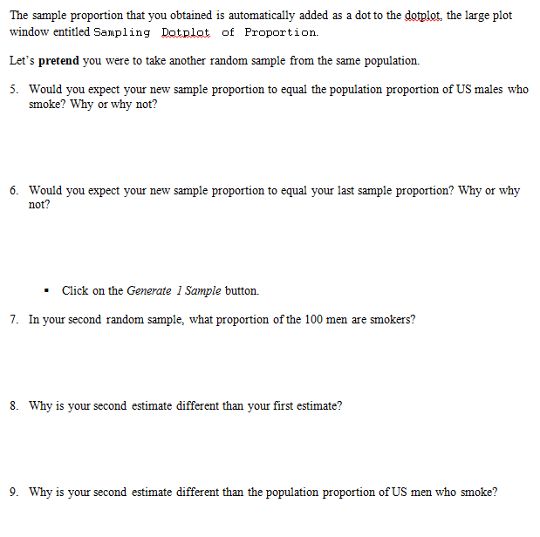
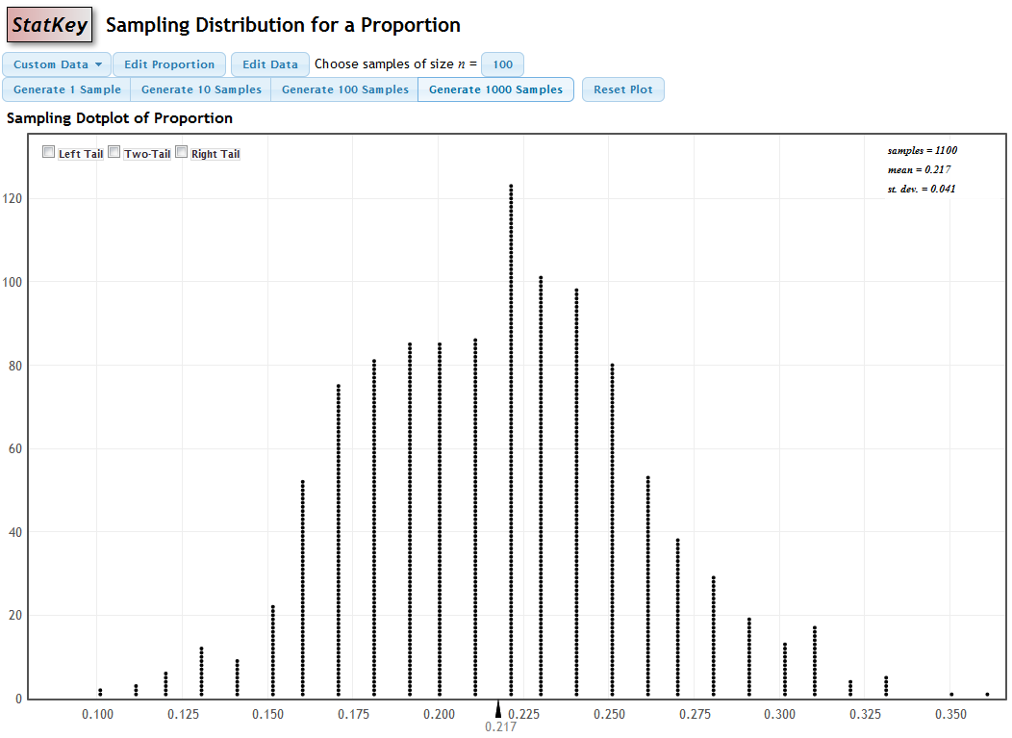
Notes:
Concept activity worksheet
Clear objective
Q&A format – typically about 4 pages long
Questions guide students through

Slide 14
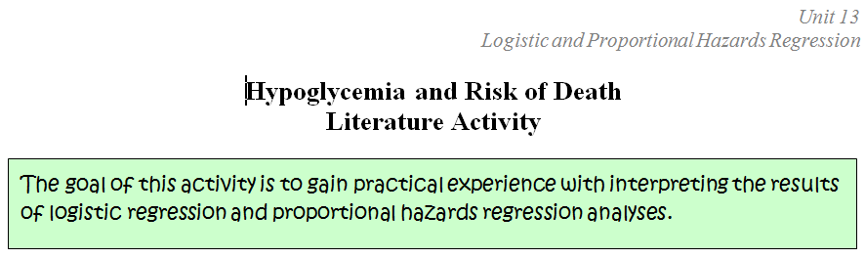
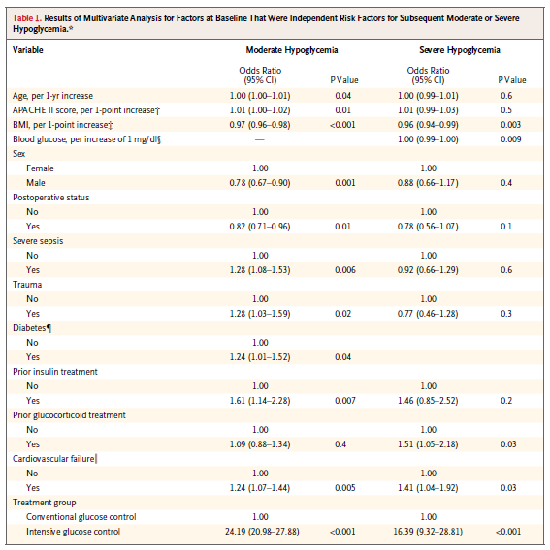
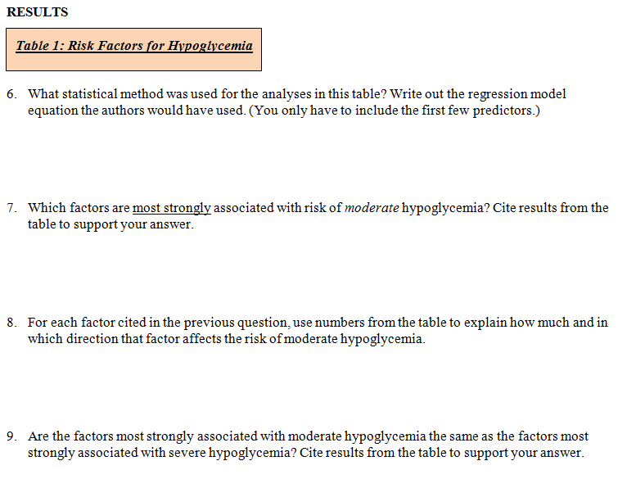
Notes:
Similar format to CA.
The literature activity typically has sections on:
- Research question and findings
- Methods
- Results
- Discussion
…so they read the WHOLE article, but the primary emphasis is on the results section, shown here.
Intentionally focus on big complicated tables and figures, to de-sensitize students.
Articles are from the current medical or public health literature.
Students read ~15 complete articles over the semester. When they find they can really read the articles in their field, they are very pleased!!
Article: “Hypoglycemia and Risk of Death in Critically Ill Patients” by the NICE-SUGAR Study Investigators (2012), N Engl J Med 2012;367:1108-18.
DOI: 10.1056/NEJMoa1204942.

Slide 15
Literacy Course End-of-Week Assessment: EOW Quiz
Summative assessment
Directly tied to the week’s learning objectives
About 6 short-essay questions, takes ~1 hr.
Administered online
Taken once, independently
Weekly, so low stakes

Slide 16
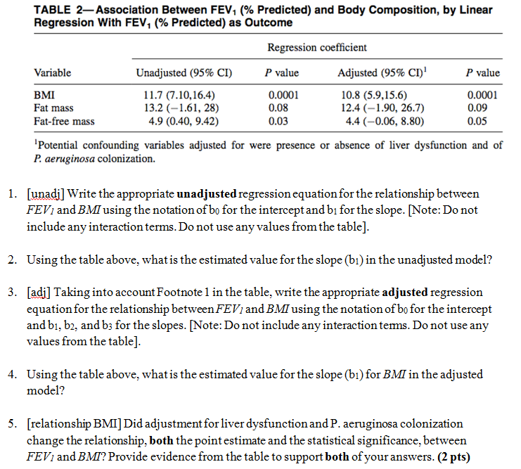
EOW Quiz Example
Notes:
Unit 12 (Multiple Linear Regression) EOW quiz.
Article reference for the table: C.C. Pedreira et al. “Association of Body Composition and Lung Function in Children with Cystic Fibrosis”. Pediatric Pulmonology 39:276–280 (2005).

Slide 17
Flipped Classroom Benefits For Students
Biostatistics is scary; active learning allows students to do the hard parts in a supportive environment, with classmates, instructors nearby to help.
vs. traditional approach: students wrestle with the hard parts alone at home doing the homework.
More challenging material can be used, since the instructors are on hand to help.
It keeps students engaged.
Learning is enhanced and reinforced by explaining to / arguing with classmates.
Plus it is way more fun!

Slide 18
Literacy Course Student Responses about the Goal
I feel much more confident now looking at scientific literature. The class was still challenging to me, but I feel more prepared to take on articles, graphs and figures and interpret them more correctly. Before this class, I had never considered whether a score was significant or not. It was up to my interpretation, ha!
I understand how to read tables, what values mean, how to assess for bias or other tricks used by authors, etc. I feel that I can better understand research articles and draw my own conclusions, which I could not do before.
I'm applying these principles in my field, in life, and as I think critically about what I'm hearing from friends or in the news. This class has increased my ability to ask the right questions of numbers.

Slide 19
Literacy Course Student Responses about the Method
I felt I learned much more by listening to lectures at home and testing knowledge with the readiness quiz, then putting my knowledge into action by working with my peers in class to put together all the information we learned.
I appreciated the opportunity to engage with the material in class. I learned so much because of the conversations with my classmates.
I was pleasantly surprised to discover the group discussions helped solidify my understanding.
The social engagement actually made me look forward to class and I helped me stay committed to attending class rather than missing it.
Completing the concept and literature activities in class [was most helpful]. I would never have had the patience or spent the time to do it at home so I really appreciated the flipped classroom.
Notes:
--Learned more
--More likely to attend class (!)
--More likely to actually do the activities

Slide 20
Flipped Classroom Benefits For Instructors
You get to spend nearly all of your classroom time engaging directly with students who really want to understand this particular question right now
vs. lecturing at students who may not be paying a whole lot of attention.
It is way more fun! When the activity is going well, there is a contented buzz of students talking and laughing.
When it is not, then you intervene and talk with the whole class to clarify the difficult concept.

Slide 21
Flipped Classroom Challenges / Barriers
Unfamiliar to students - need to manage expectations
Student: “The flipped classroom style was LEAST helpful until I had tried it and understood it. The first three-four weeks of class were frustrating and exhausting. Suddenly, after I'd been through the unfamiliar process several times, I began to appreciate and feel more confident with it.”
Unfamiliar to instructors – no longer the center of attention
You may feel at first that you are not “doing anything useful” as you wander around the classroom listening and observing.
Classroom must allow students to work together in groups (e.g. movable tables and chairs)
For classes larger than 25 students, more than one instructor needs to be present in the room
Requires more upfront work than simply giving a lecture – more like developing an online class.
Notes:
Classroom TA.

Slide 22
Flipped Classroom Easing Into Active Learning
Traditional / All lecture
Leave blanks in the lecture slides (or provide a worksheet) for students to fill in as they listen
Add periodic questions to the lecture; use audience-response systems to assess the class’ understanding
Clickers, Twitter, colored cards, …
Remove the examples from the lecture slides and turn them into activities for the students to do in class
Give “mini-lectures” to review the textbook material
Flipped / No lecture
Notes:
General principle: Students listen less and do more, instructor does less and listens more.

Slide 23
Acknowledgements
My PubH 6414 co-instructor, Laura J. Le
Our awesome Biostatistics teaching group
Our School of Public Health’s Office of E-Learning Services, led by Dr. Sara J. Hurley
Prof. Bradley P. Carlin, Biostatistics Division Head

